Slide 1

async programming in JS Part1
your desire to avoid the mess of callbacks is not justification for blocking, synchronous code
(@getify, Kyle Simpson)

Slide 2
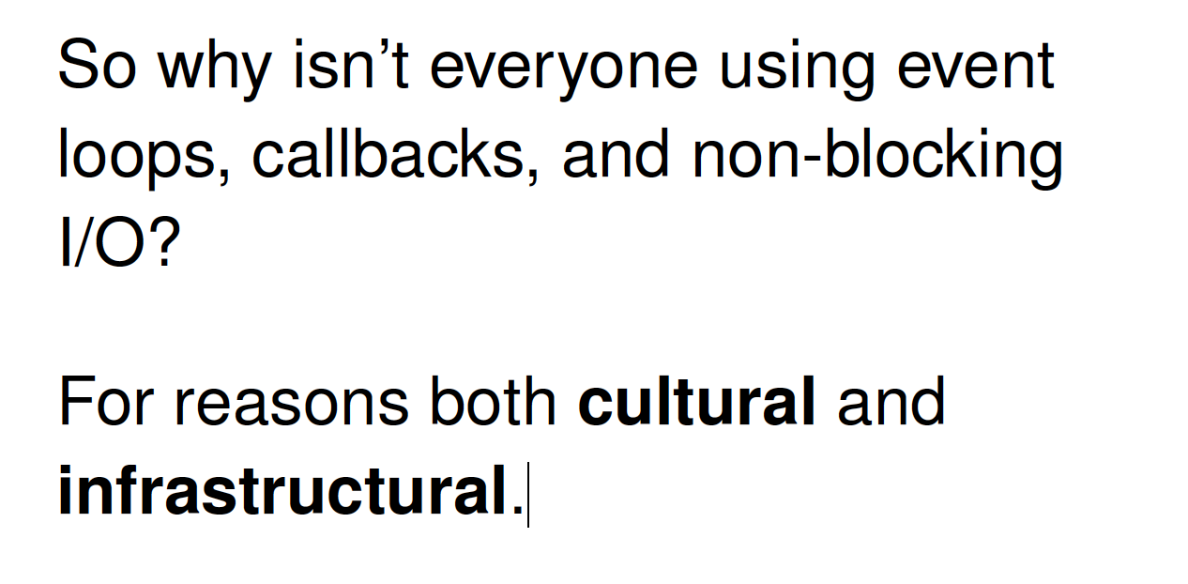


Why we need this lesson ?
Developeri sú leniví naučiť sa a používať async patterny a radi skĺznu ku komfortnému a prirodzenejšiemu
synchrónnemu a
buffrovanému kódu
Node.js a JavaScript je o
asynch a
chunk processingu
Ak to nechcete, programujte v inom jazyku....
Už teraz je dosť zlých JS knižníc a kódov na svete....
your desire to avoid the mess of callbacks is not justification for blocking, synchronous code (@getify, Kyle Simpson)
That's just not really how our brains appear to be set up.

Slide 3
Recap, node.js design
To provide a purely evented, non-blocking infrastructure to script highly concurrent programs (web servers,...)
The API should should be fammiliar to client side JS programmers and old school UNIX hackers
No function should directly perform IO
To receive info from disk, net or another process, there must be callback
Stream everything, never force buffering of data
Have build-in support for most important protocols TCP, DNS, HTTP

Slide 4
Recap - callbacks
When your JS program makes async operation, you set up the "response" code in a function (commonly called a "callback"), and the JS engine tells the hosting environment, "Hey, I'm going to suspend execution for now, but whenever you finish with that request, and you have some data, please call this function back.“ (@getify)
Cooeration of JS engine and hosting environment
Chunks of program – main and functions
Event loop

Slide 5
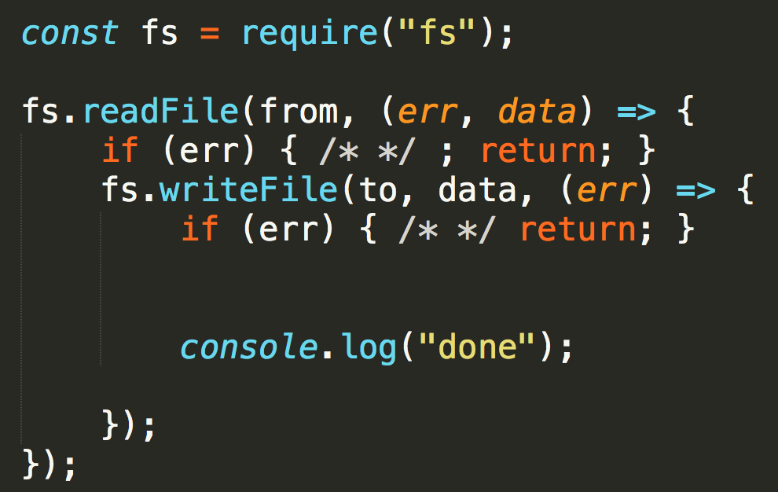
Recap – “všetok“ váš kód bude vyzerať nejako takto
Async Callbacks
most typical API in node.js core and userland modules
function call does not return data
instead function call accepts another function as parameter (callback)
expected function signature is commonly (err,data) or (err)
nesting of callbacks to achieve more steps in algorithm

Slide 6
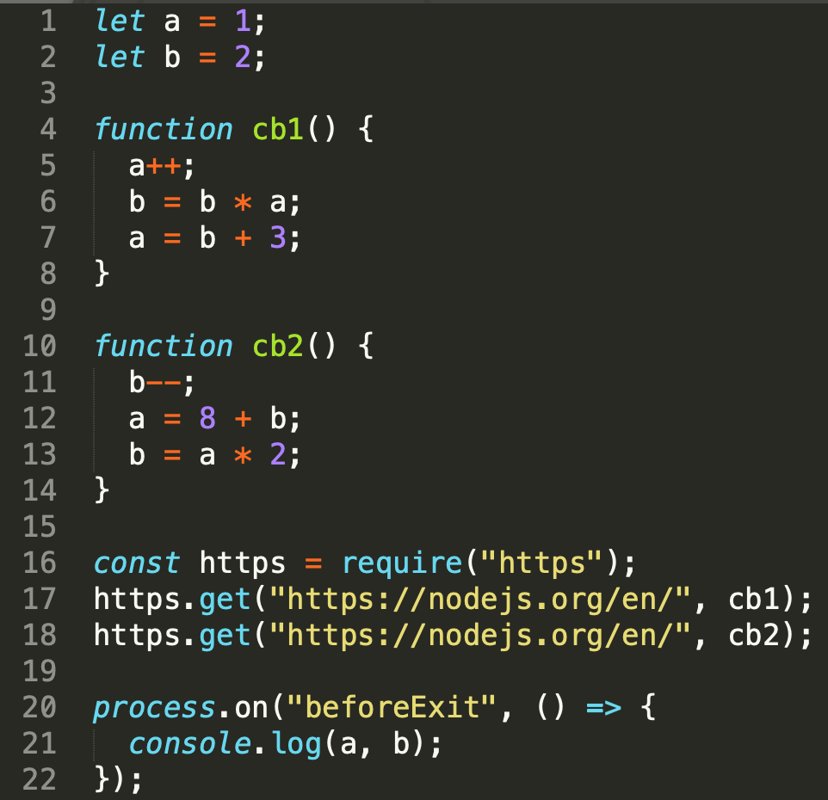
Recap ... a bežať nejako takto....
1)
„compile“
4
10
global
cb1
cb2
V8 stack
1
2
16
17
18
20
5
6
7
11
12
13
21
node
2)
4
10
global
cb2
cb1
time
1
2
16
17
18
20
11
12
13
5
6
7
21
wait in queue
async: some code happends now [1,2,...] and some later [5,5,6], [11,12,13],[21]
concurrent: callbacks happen in certain timeframe but not in predictable and controllable order
run-to-completion: function is „atomic“ unit and must execute as whole, there is no chance for (11,5,12,... to happen)
$ node ./concurrency.js
11 22
$ node ./concurrency.js
11 22
$ node ./concurrency.js
183 180
$ node ./concurrency.js
11 22
/samples/concurrency.js
Notes:
Because cb1() can't be interrupted by cb2(), and cb2() can't be interrupted by cb1(),
this program only has two possible outcomes depending on which starts running first –
if threading were present, and the individual statements in cb1() and cb2() could be interleaved, the number of possible outcomes would be greatly increased

Slide 7
async code styles

Slide 8
History of async
JS ako jazyk nemal žiadnu notáciu pre asynchronicitu
Callback bol fajn mechanizmus ako to zapísať syntakticky a čiastočne aj semanticky (všetko čo je odtabované je “LATER“)
Callback ako taký ale nič nevraví o asynchronicite
promises (ako nezávislý štandard) potom ako súčasť ES
generatory
async await
async iterators

Slide 9
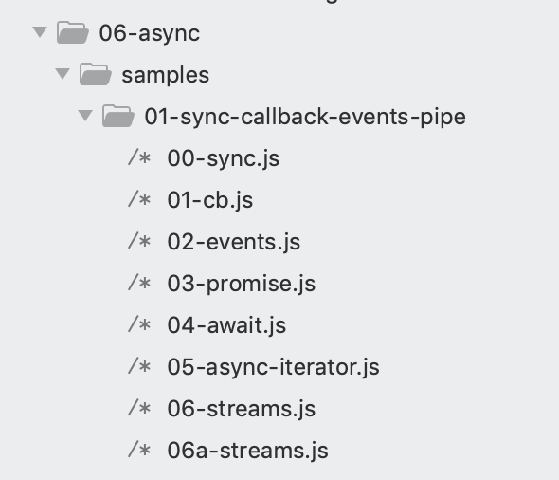
Async styles
sync
async callback
async events
async promises
async async/await
async iterators/generators
streaming, pipe, pipeline
node.js core module fs is a good demo of all styles, it supports all of them, samples:
Notes:
core module “fs”, File System, je vyborny priklad, poskytuje vsecky api aby sme si to vedeli ukazat

Slide 10
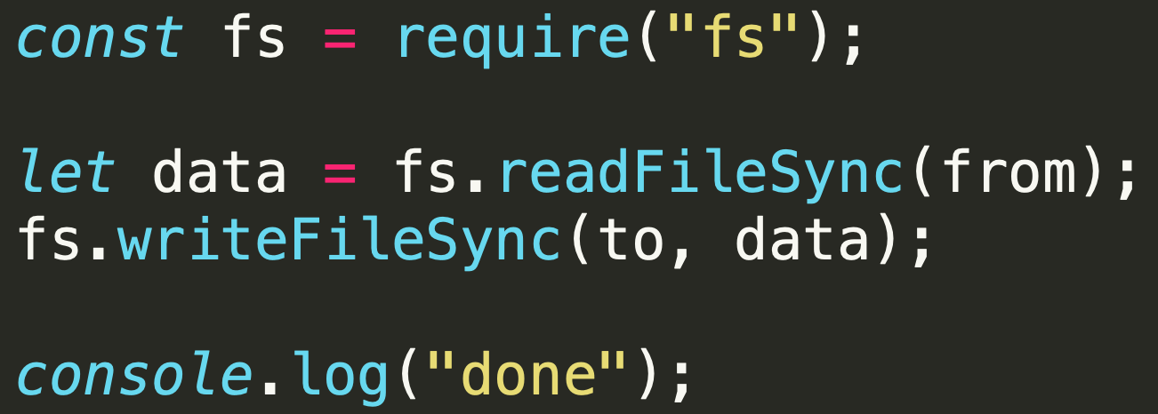
Async styles – sync
simple
readable
blocking
buffering

Slide 11
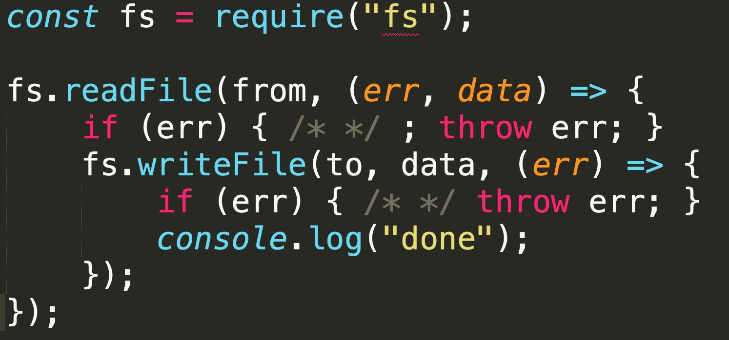
Async styles – (single) callback
simple
readable
non-blocking
buffering
callback sa vykoná raz zo všetkými dátami

Slide 12
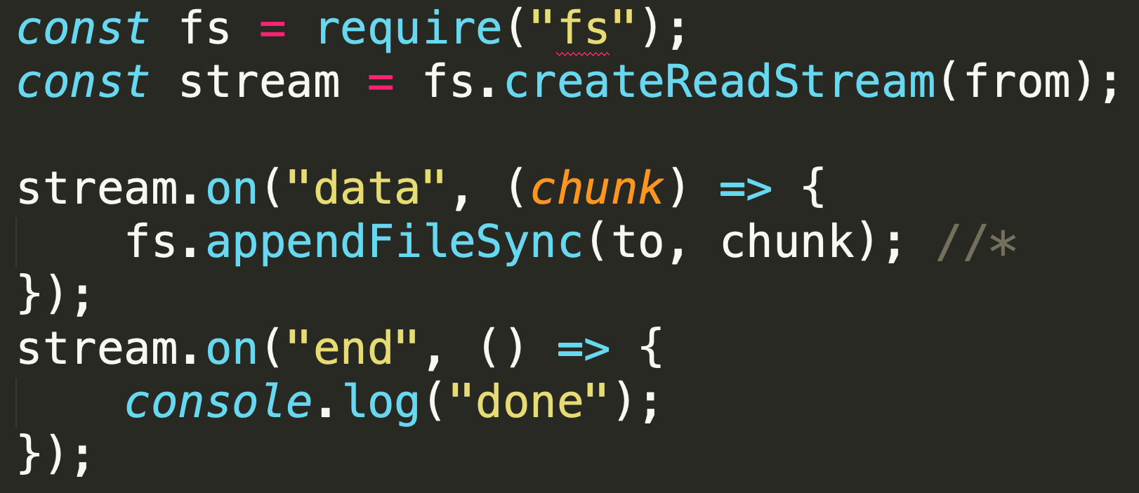
Async styles – events (simplified*)
simple
readable
non-blocking
not buffering
unless you buffer yourself
callback sa vykoná vela krát z čiastočnými dátami

Slide 13
Async styles – events – fully evented version ?
https://stackoverflow.com/questions/11293857/fastest-way-to-copy-file-in-node-js
;-))))))
simple
readable
non-blocking
not buffering
unless you buffer yourself
callback sa vykoná vela krát z čiastočnými dátami

Slide 14
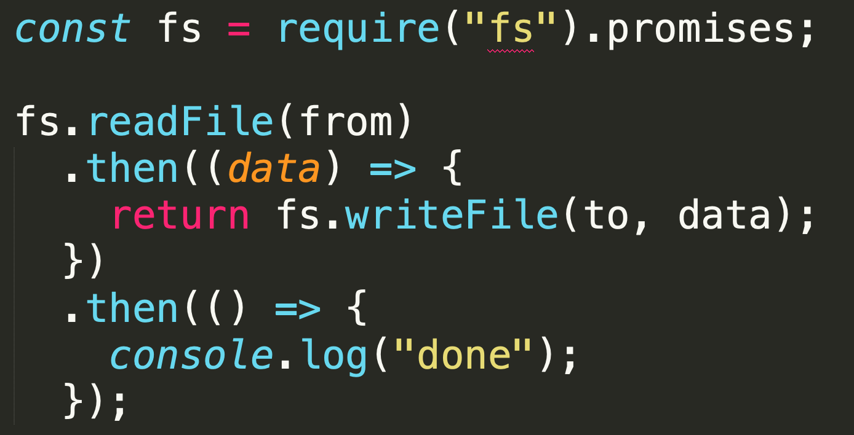
Async styles – promises
simple
readable
non-blocking
buffering
promise sa rezolvne raz zo všetkými dátami

Slide 15
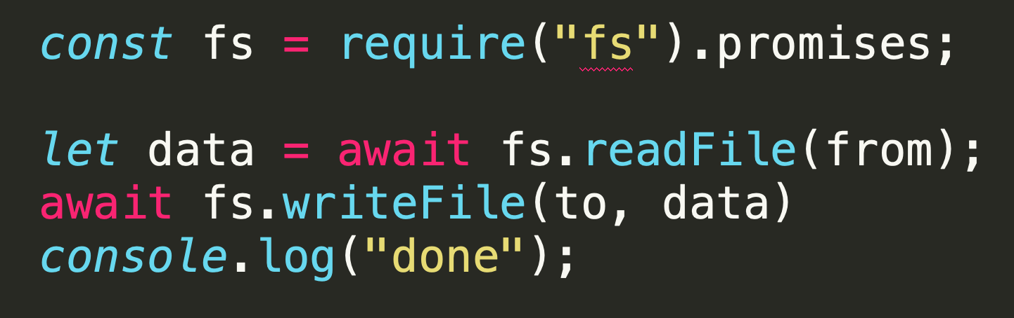
Async styles – await
simple
readable
non-blocking
buffering
promise sa rezolvne raz zo všetkými dátami

Slide 16
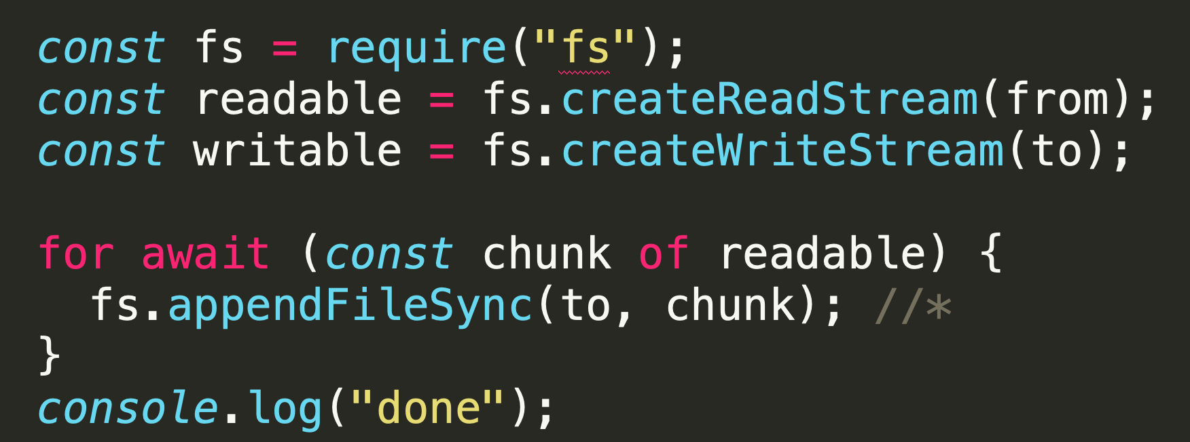
Async styles – async iterators (simplified*)
simple
readable
non-blocking
not-buffering
https://nodejs.org/api/stream.html#stream_consuming_readable_streams_with_async_iterators

Slide 17
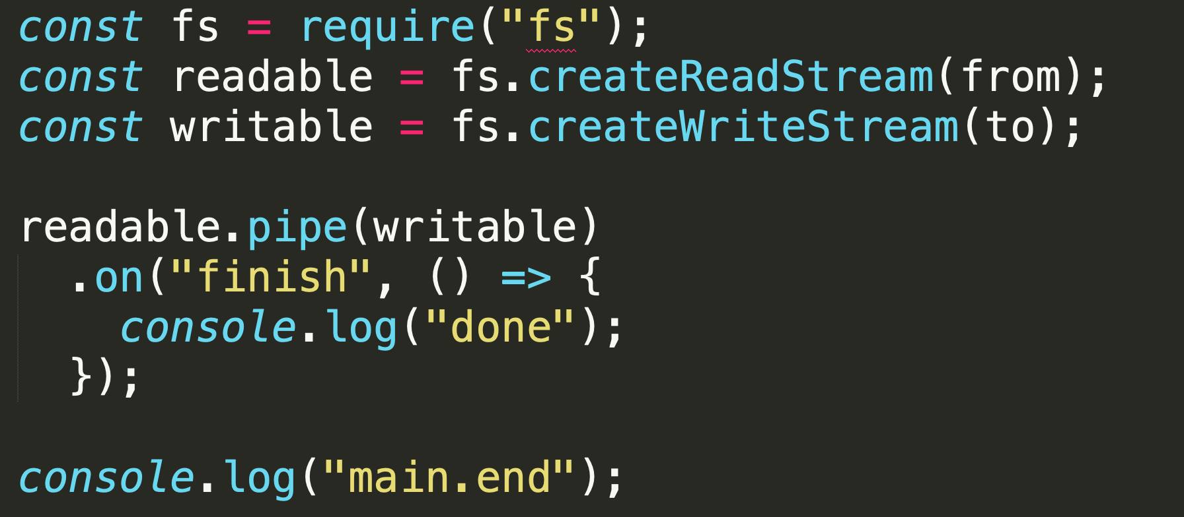
Async styles – streams
simple
readable
non-blocking
not buffering
pipe – returns stream with events
looks like sync API by original definiction, but is evented again

Slide 18
Async styles – streams
simple
readable
non-blocking
not buffering
pipe – returns stream
looks like sync API (no callback), but is evented again
Mixing pipe with events

Slide 19
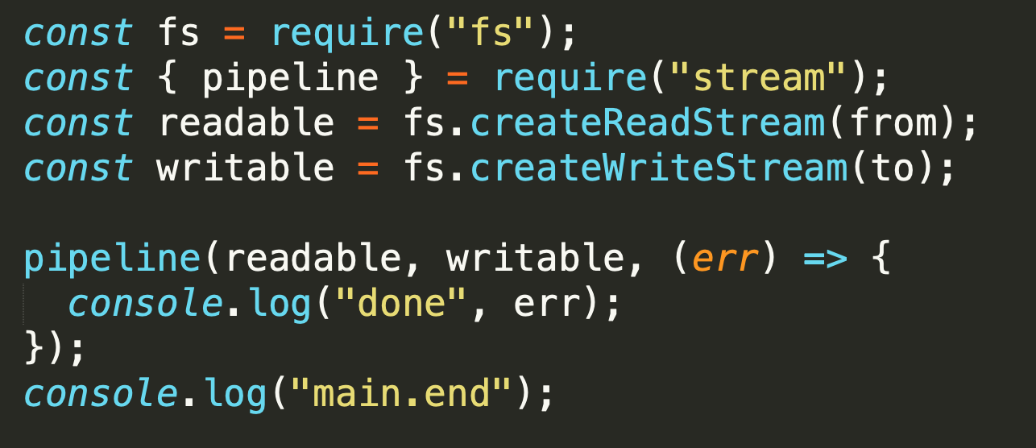
Async styles – pipeline utility
simple
readable
non-blocking
not buffering
pipe – returns stream
looks like async API
Single done callback

Slide 20
Async, concurrent, async function….
Nejaká základná terminológia

Slide 21
What is async and concurrency
Async
async is about the gap between now and later
Implementation: Event loop
Granularity: function is single event loop queue entry
Parallel
things being able to execute at the same instant of time
Implementation: processes, threads
Granularity: Each statement is broken to several low-level operations
Concurrency
several higher level „tasks“ occuring within same time frame (simultaneously).
Not necesarilly in the same instant of time (paralell).
Notes:
Definitions good enough for JS

Slide 22
Async and Concurrency
1)
„compile“
4
10
global
cb1
cb2
V8 stack
1
2
16
17
18
20
5
6
7
11
12
13
21
node
2)
4
10
global
cb2
cb1
time
1
2
16
17
18
20
11
12
13
5
6
7
21
wait in queue
async: some code happends now [1,2,...] and some later [5,5,6], [11,12,13],[21]
concurrent: callbacks happen in certain timeframe but not in predictable and controllable order
run-to-completion: function is „atomic“ unit and must execute as whole, there is no chance for (11,5,12,... to happen)
$ node ./concurrency.js
11 22
$ node ./concurrency.js
11 22
$ node ./concurrency.js
183 180
$ node ./concurrency.js
11 22
/samples/concurrency.js
Notes:
Because cb1() can't be interrupted by cb2(), and cb2() can't be interrupted by cb1(),
this program only has two possible outcomes depending on which starts running first –
if threading were present, and the individual statements in cb1() and cb2() could be interleaved, the number of possible outcomes would be greatly increased

Slide 23
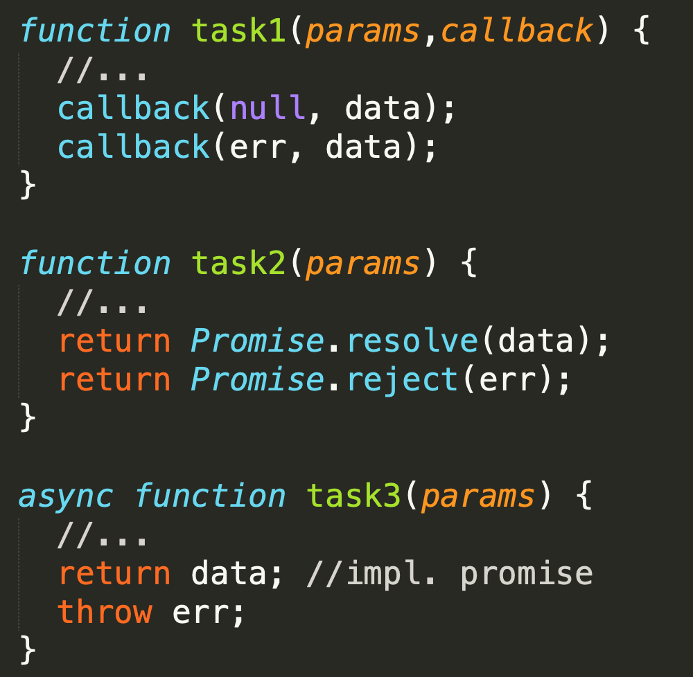
Async function - definitions
now
later
V8 stack
Pod async funkciou budeme zjednodušenie rozumieť jednu z konštrukcií, ktorá nám umožní zapísať, že niečo sa deje NOW a potom LATER. V zásade existujú 3 možnosti ako je async funkcia implementovaná:
funkcia, ktorá v signatúre očakáva callback
funkcia, ktorá vracia Promise
ES2017 AsyncFunction

Slide 24
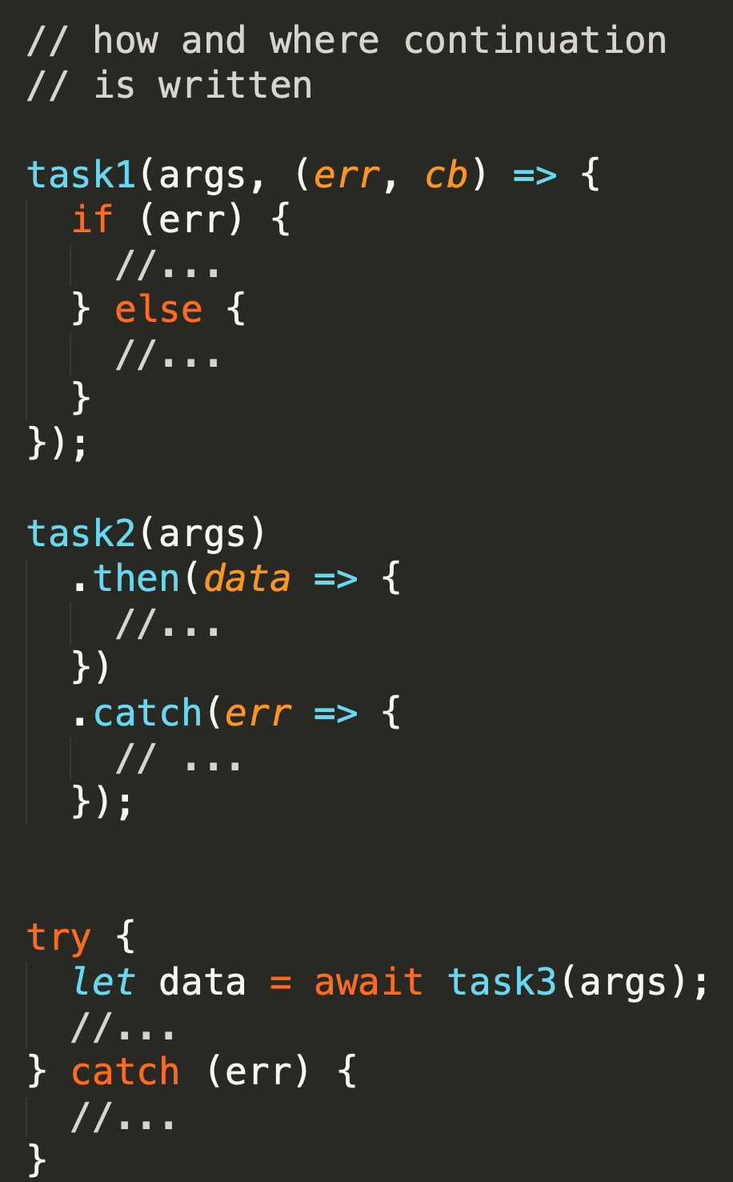
Async function - usage
1995-2020
now
later
V8 stack
Podľa toho potom rôzne zapisujeme „later“
funkcia, ktorá v signatúre očakáva callback
funkcia, ktorá vracia Promise
ES2017 AsyncFunction
Niektoré knižnice sú napísané štýlom A) iné B) iné podporujú A/B/C ..... Niektoré runtimes podporujú len A, niektoré A,B,C
2010
2015-2020
2017-2020

Slide 25
Async process
fs.mkdtemp
()=>fs.writeFile
cb
V8 stack
http.get
on(data)
on(data)
on(end)
async procesom alebo taskom budeme rozumieť logickú úlohu pozostávajúcu z viacerých časovo oddelene vykonávaných chunkov kódu
V príklade zobrazené dva procesy:
Zápis do temp súboru
Čítanie dát z web stránky

Slide 26
Concurrency coordination
fs.mkdtemp
()=>fs.writeFile
cb
V8 stack
on(data)
on(data)
on(end)
„process“ or „task“
in the majority of slides here, it means higher abstraction of some logical process to be performed (process server response, animate rotation of globe, print response results, process client request) of various granularity (viac funkcií volaných later)
Noninteracting
As two or more "processes" are interleaving their steps/events concurrently within the same program, they don't necessarily need to interact with each other if the tasks are unrelated. If they don't interact, nondeterminism is perfectly acceptable.
Interaction
More commonly, concurrent "processes" will by necessity interact, indirectly through scope and/or the DOM. When such interaction will occur, you need to coordinate these interactions to prevent "race conditions“.
Cooperative concurrency
Another expression of concurrency coordination is called "cooperative concurrency.“ The goal is to take a long-running "process" and break it up into steps or batches so that other concurrent "processes" have a chance to interleave their operations into the event loop queue.

Slide 27
Async Patterns
because concurrency coordination is needed ….

Slide 28
Čo riešime za úlohy
Všetci už vieme, že JS je:
asynchrónny,
single threaded (nikdy nebežia dve veci naraz v JS stacku)
atomický a run-to-completion na úrovni funkcie
Potom čokoľvek programujeme nejaký top level async process treba posudzovať z hľadiska async patternov
buď jednotlivo
alebo ako ich kombináciu
ES/JS a node.js majú limitovaný zabudovaný mechanizmus na ovládanie interaction medzi úlohami, na riešenie cooperative concurency (async.js a iné knižnice)

Slide 29
Prečo to riešime
V JS je “všecko async“ a beží “concurrentne“
V iných jazykoch si to musíte explicitne kódnuť inak ste blocking a serializovaný
V JS to musíte riešiť od prvého dňa a naučiť sa bohužiaľ čítať všetky štýly a písať aspoň niektoré z nich
Mali by ste JS concurrency využívať a nie bojovať proti nej

Slide 30
Čo riešime za úlohy – klasifikácia vzorov
series/parralel - musia ísť úlohy za sebou (series) alebo môžu íst paralelne (parallelne)
results passing/cummulating - ak idú za sebou potrebuje tá ďalšia dáta z predošlej, alebo nám záleží len na poradí vykonania
[] of async-functions/[] of data + worker – robím rôzne veci, alebo robím to isté nad inými dátami
[] / queue, doWhilst,... - je zoznam úloh konečný alebo je dynamický a úlohy pribúdajú alebo odbúdajú
try, race – potrebujem výsledok len prvej dokončenej úlohy
limits –paralell limits, timeouts
errors – kedy a ako sú signalizované chyby

Slide 31
Async.js
Terminológia vzorov na nasledovných slajdov a ukážky kódov používajú knižnicu async.js
Async is a utility module which provides straight-forward, powerful functions for working with asynchronous JavaScript. Although originally designed for use with Node.js and installable via npm install async, it can also be used directly in the browser.
https://caolan.github.io/async/v3/
Existujú samozrejme iné knižnice
http://bluebirdjs.com/docs/getting-started.html
...
Prečo async.js
Async.js vznikla v čase callbackov a riešila peknou syntaxou to čo by inak malo šialené povnárané zápisy ,
Dnes podporuje aj promises a async function, a dá sa tak použiť ako jednotná abstrakcia, nezávisle od APIčka knižníc z ktorými kódujete
Veľa paternov sa dá napísať aj pomocou promises, alebo async iterátorov, ale nie všetky a nie na každom runtime (nie všetci bežia latest node a latest chrome)

Slide 32
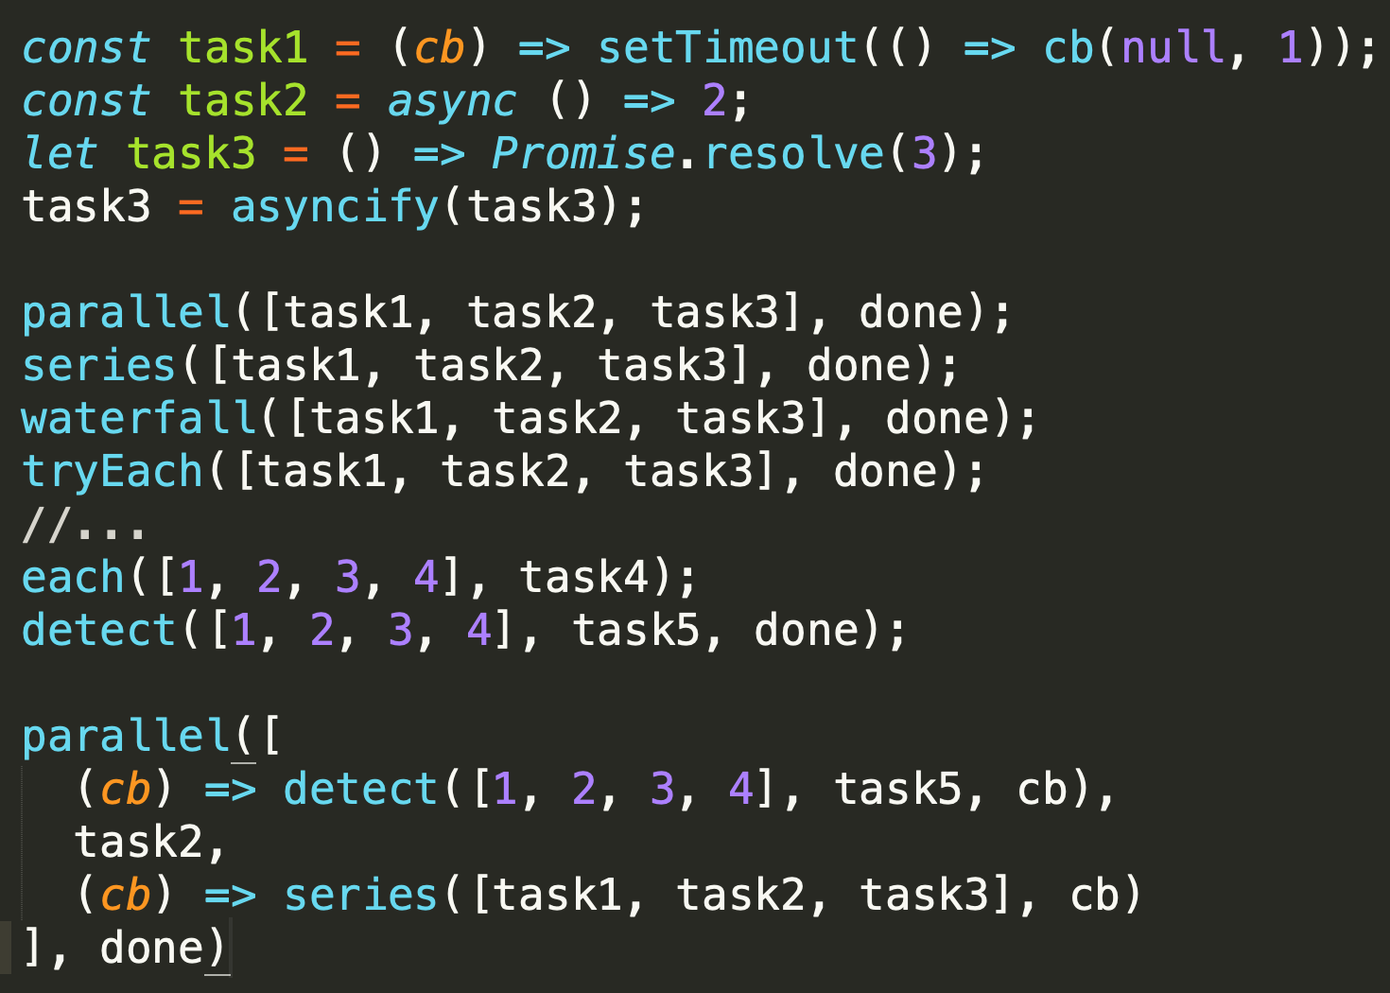
Intro
Majme nejake async funkcie (tasky)
Povedzme si ako ich chceme vykonať a akú koordináciu potrebujeme
Zvoľme vhodný pattern z knižnice
c) Function returning promise requires conversion with asyncify
Sampel je len ilustratívny.....

Slide 33
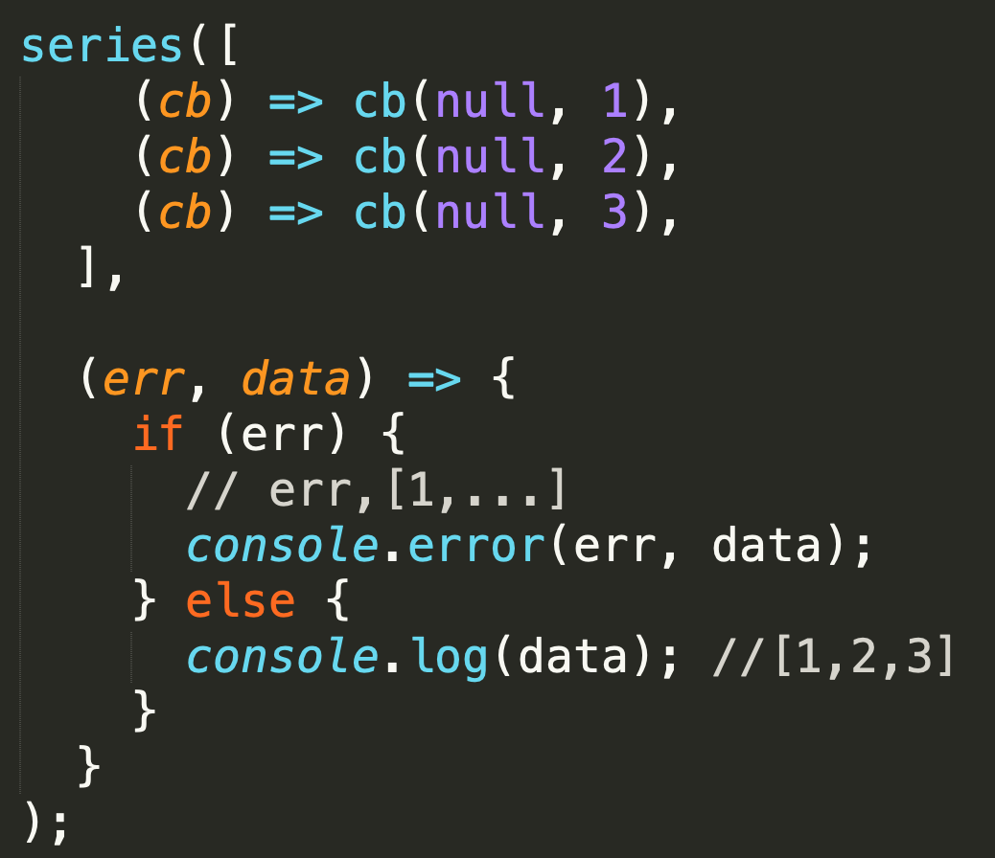
Series
simplest sequential
Use when:
tasks are dependent on order of execution
but do not need data from previous task
data returned from tasks can be collected in final callback
Notes:
Preco potrebujeme series ?
No prave preto ze standardne nevieme rozumne zaradit ulogy sekvencne za seba,
ked napisem normalny JS kod
a()
b()
tak sa mi a aj b pustia naraz a ich callbacky budu v poradi cba(), cbb(), alebo cbb(), cba()
ak sa tomu chcem vyhnut, musim robit sequence
----------
TODO: Co ak chcem ale iny pattern pustit tasky naraz a sycnronizovat len poradie callbackov ?

Slide 34
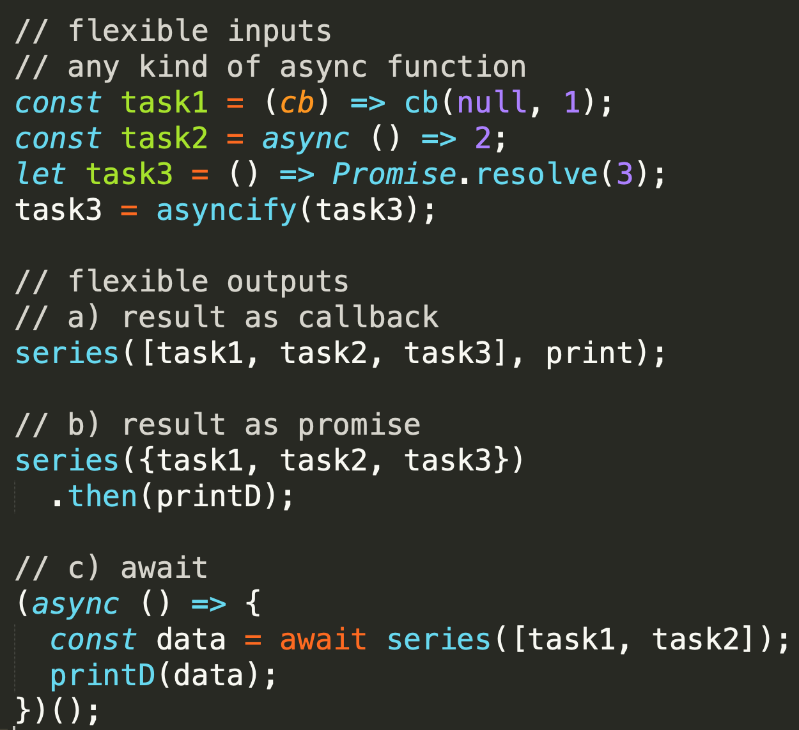
Series
Výhodou async.js je aj flexibilita návratových hodnôt
Ak chcete po dobehnutí môžete volať callback
Ale si výsledok vyzdvihnete ako promise
Alebo si na neho počkáte cez await

Slide 35
Series
TODO: Real life example ?

Slide 36
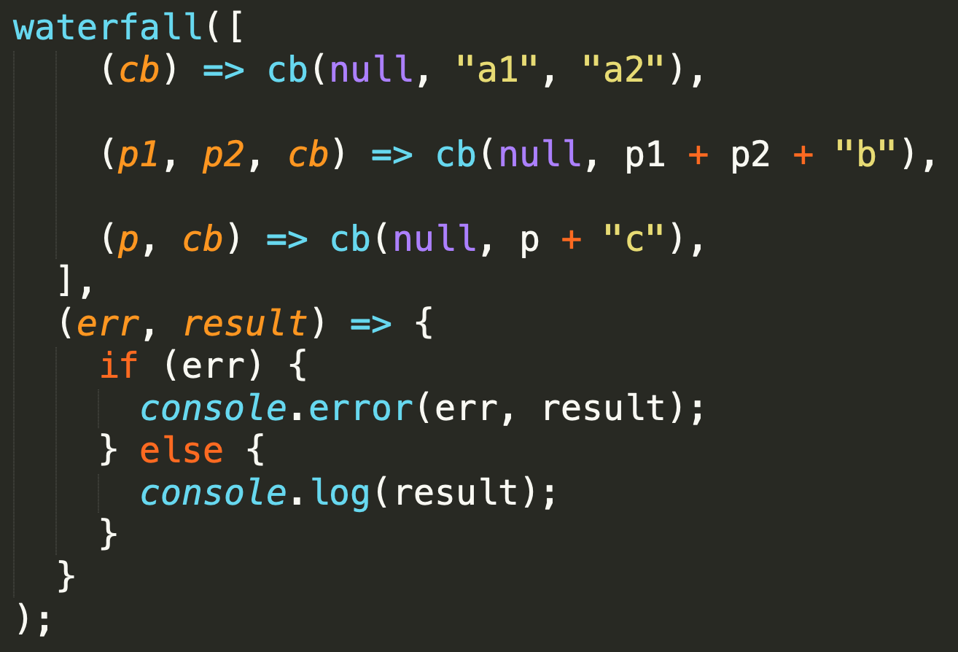
Waterfall
sequential
Use when:
tasks are using data from previous task
next task gets data from returned from previous task
final callback gets data of last task

Slide 37
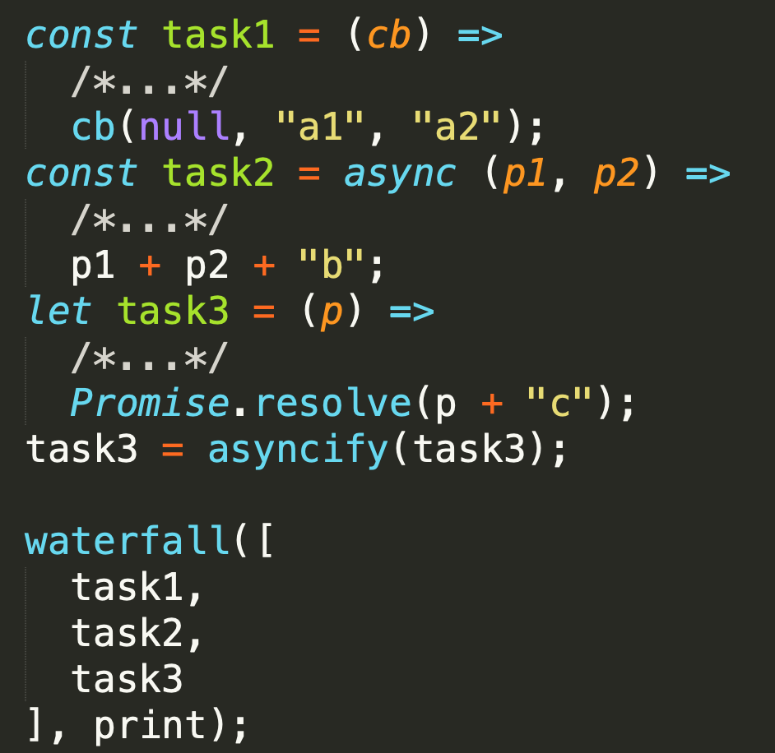
Waterfall
Znova platí, že kľudne vieme zmixovať async funkcie rôznych typov
a ak majú vhodné signatúry vieme ich priamo zapísať do waterfall
Ak nie “adaptneme“ ich cez arrows
Ak su tam nejake sync kroky, zaradime ich ako funkcie do waterfall alebo dnuka do arrows
Zase veľmi pekný, deklaratívny zápis, bez arrows a lúštenia kódu vieme čo to robí až potom čítame ako to robí.....

Slide 38
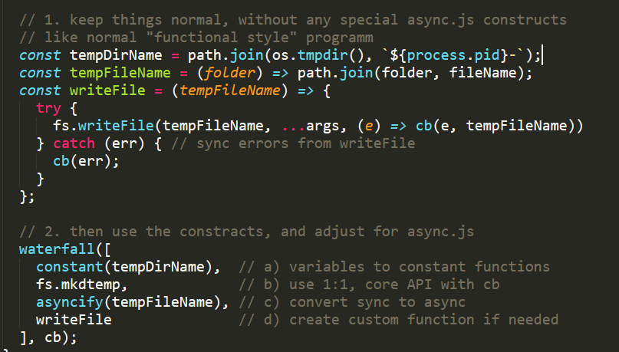
Waterfall
TODO: budeme robit na cviku, writeTempFile ako sekvenciu 2 async funkcii z node.js
toto je jedna z moznych variant ako k tomu pristupit

Slide 39
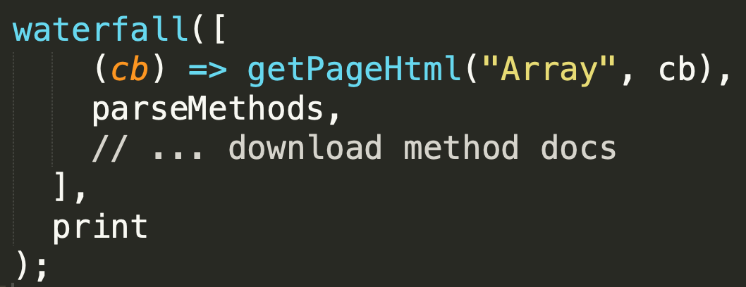
Waterfall
V samploch mate trivi priklad na vykradanie JS dokumentacie
/samples/03-patterns/03a-waterfall-scrape-mdn.js

Slide 40
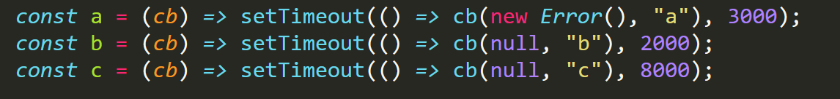
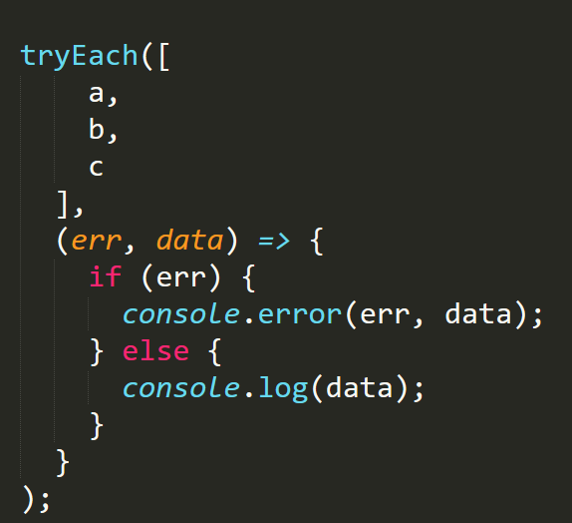

tryEach
sequential
It runs each task in series but stops whenever any of the functions were successful
Use when:
you have more alternatives to perform the task and first succesfull is enough
If one of the tasks were successful, the callback will be passed the result of the successful task
if all fail, cb will be called with error of last attempt

Slide 41
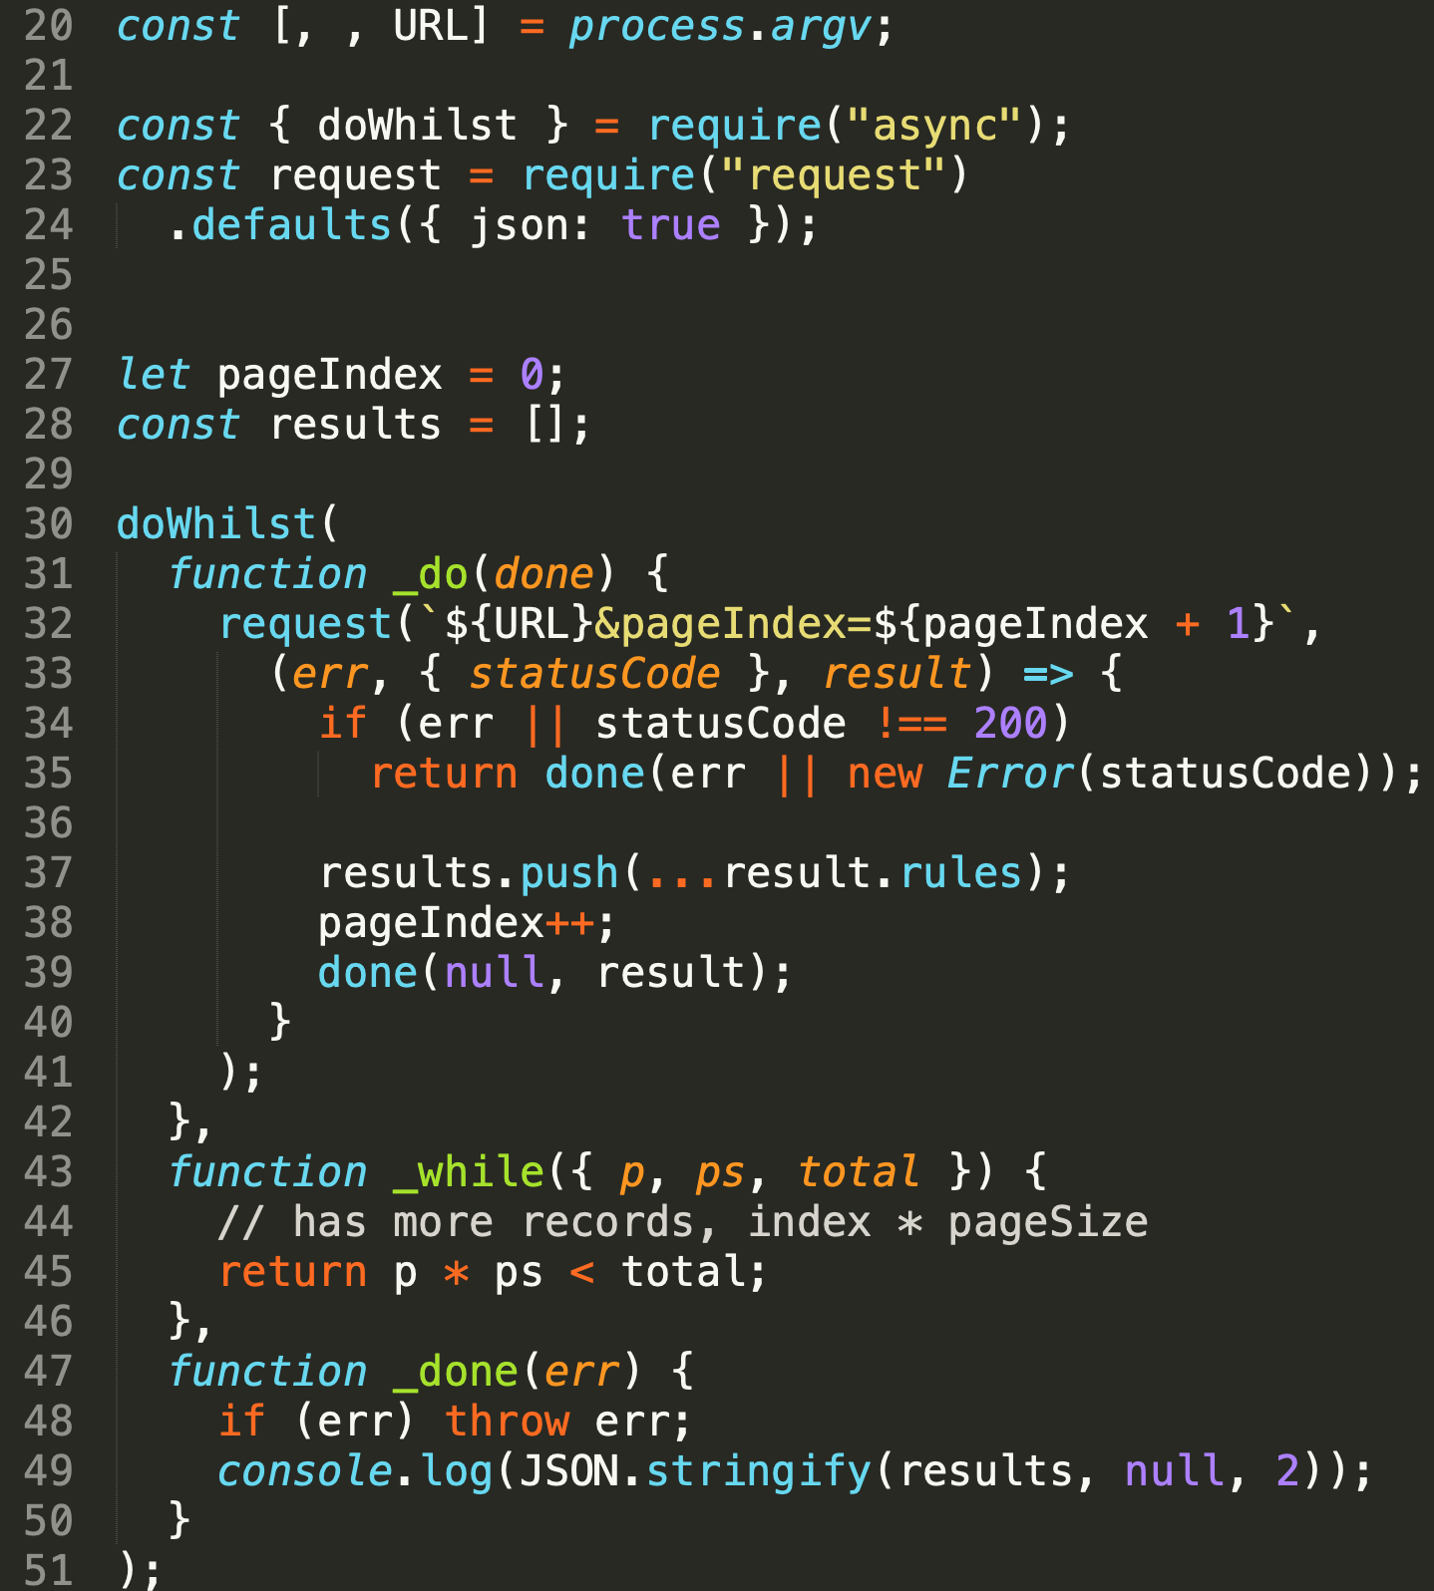
doWhilst
sequential – do...while for async functions,
do, while and done are all functions, while is sync test
Use when:
algorithms is best desribed by do...while but
do contains some async function
last
real life example: sonar API, paged search
/samples/sonar-rules-cli.js
Notes:
Pozor uveredny sample pouziva staru verziu async kde test funkcia bola synchronna, teraz je asynchronna a ma callback, nie return value
Fixnuta verzia je v ramci cviceni.

Slide 42
Running in series
un ordered callbacks
Normal JS code
t1
t2
t3
c2
c3
c1
V8 stack
node
ordered calls and callbacks
Series/waterfall/awaits
V8 stack
t1
c1
t2
c2
t3
c3
node
unordered calls
ordered callbacks
???
t1
t2
t3
c1
c2
c3
V8 stack
node

Slide 43
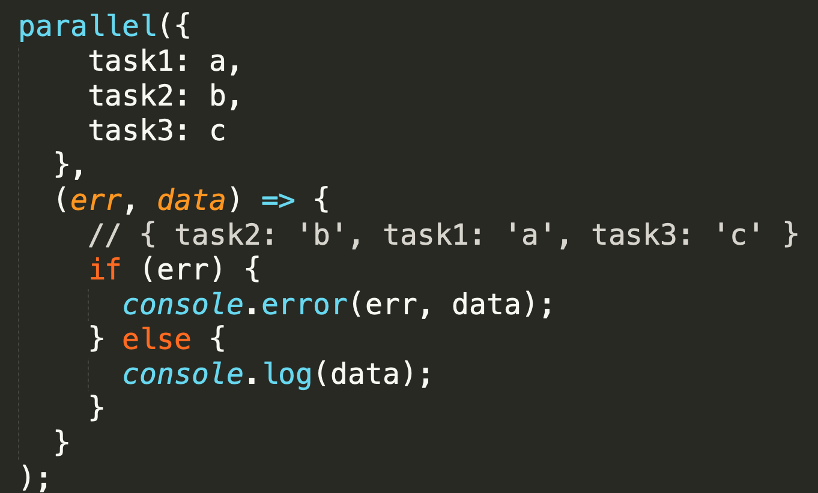
parallel
parallel
Use when:
you have independent processes
you need to wait for all of them to execute and then continue
you want to collect results from all of them

Slide 44
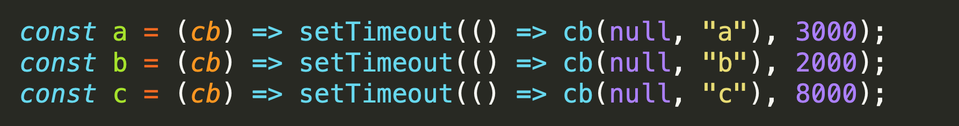

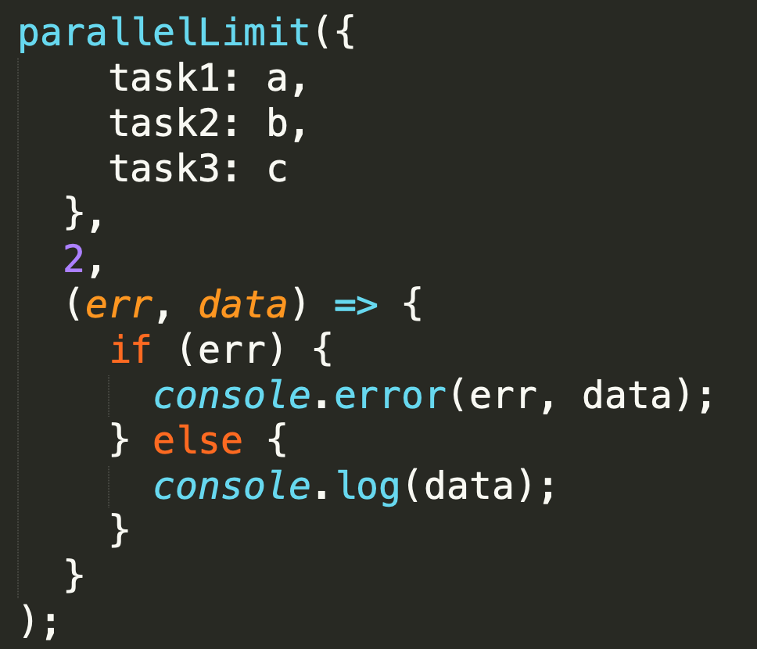
parallelLimit
The same as parallel but runs a maximum of limit async operations at a time.
koľko približne bude trvať tento program ?
ak limit je 2 ?
a tasky trvajú 3,2 a 8 sekúnd

Slide 45
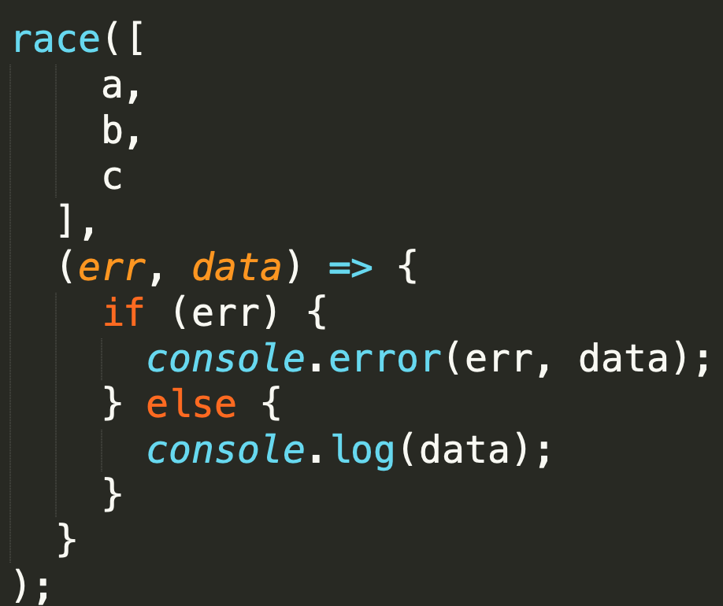
race
parallel - Once any of the tasks complete or pass an error to its callback, the main callback is immediately called.
Use when:
podobne ako sekvenčný tryEach teda ak máte alternatívne algoritmy a stačí vám výsledok najrýchlejšieho
Ale pozor:
ak najrýchlejší spadne aj callback sa zavolá z chybou
v ok aj v err scenári - nik nezabezpečí odplánovanie tých spustených timerov
koľko teda pobeží tento program
po callback ?
po úplný koniec node procesu ?

Slide 46
any
parallel
Problém z race:
ak najrýchlejší spadne aj callback sa zavolá z chybou
Často ale potrebujeme iný scenár, teda prvý úspešný výsledok toho co zbehol bez chyby ako prvy
a uplny error, až keď všetky zlyhajú
TODO: máme v async.js paralelný pattern z takouto semantikou ? Pohladajte si v doksoch k async.js
See: https://esdiscuss.org/topic/promise-any

Slide 47
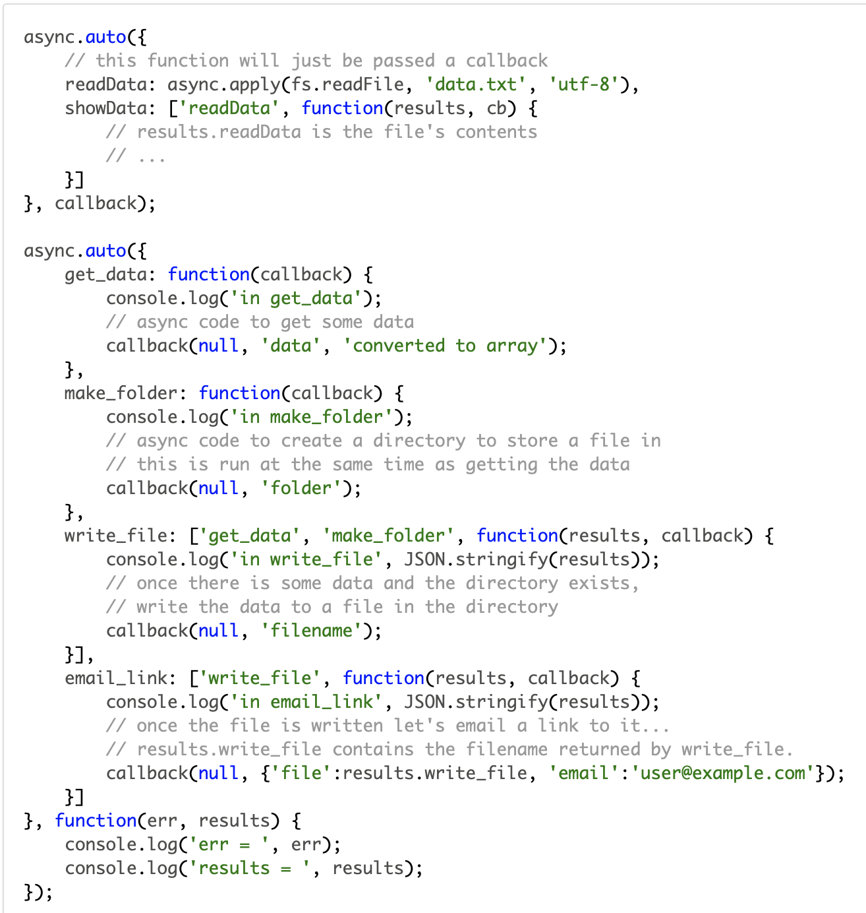
auto, autoInject
executes in best order based on requirements
Deklaratívny zápis
čo chcete dosiahnuť a
čo na každý task potrebujete
Notes:
Pusti sa
get_data
make_folder
Ked dobehne get_data a make_folder pusti sa write_file a potom email_link
Sample su z doksov async.js

Slide 48
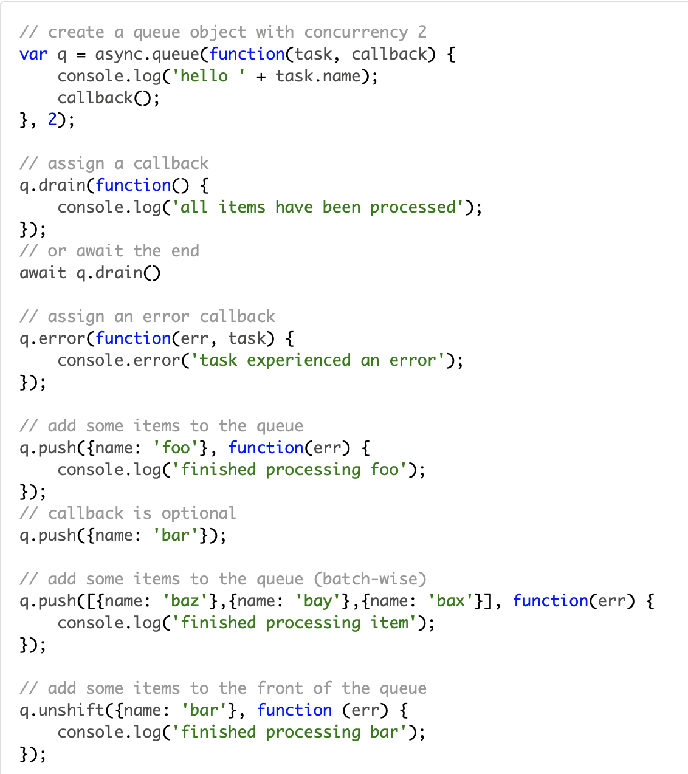
Queue
parallel
Use when:
ak neviete dopredu zoznam taskov a postupne pribúdajú
Why:
Paterny čo sme si doteraz ukázali pracovali spravidla zo známym počtom itemov
Creates a queue object with the specified concurrency. Tasks added to the queue are processed in parallel (up to the concurrency limit). If all workers are in progress, the task is queued until one becomes available. Once a worker completes a task, that task's callback is called.

Slide 49
Cargo

Slide 50
Patterns - for tasks/ flows coordination
coordinating various async tasks represented by different async functions
or chunks (cargo), or datas (queue)
for serial and parallel usage
declarative dependencies and automatic ordering with auto

Slide 51
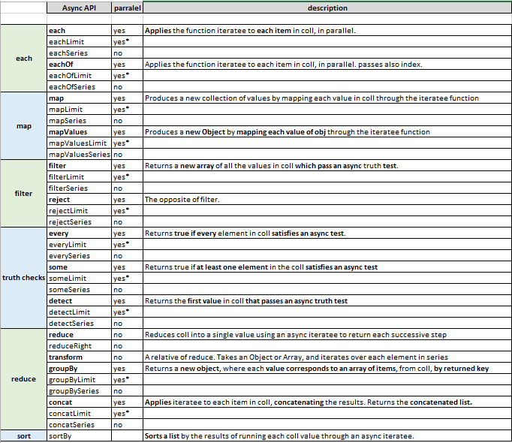
Patterns – for data collections
when you want to run same async algorithm over collection of data
mostly Array functions: map, filter, .... just with async function as callback (iteratee)

Slide 52
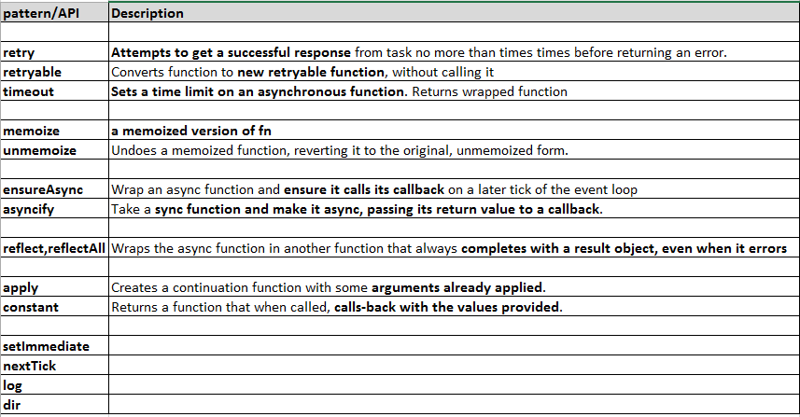
Patterns – for single function
basic async patterns and helpers to be applied on function.
Mostly return wrapped function suitable for another async usage.

Slide 53
Cooperative Concurrency
The World will stop

Slide 54
Cooperative Concurrency
What:
The goal is to take a long-running "process"
and break it up into steps or batches or chunks
so that other concurrent "processes" have a chance to interleave their operations into the event loop queue
Why:
to receive better performance of simultaneously running processes in single threaded environment
This applies to both Noninteracting and Interacting „processes“

Slide 55
Cooperative Concurrency
if callback takes a lot of time,
eg. processes a lot of data items in „loop“
nothing else can happen:
in browser – no rendering, no clicks, ....
on web server – no other requests can be served
The idea is to split processing to „chunks“,
give up stack after processing partial chunk
schedule next chunk processing
this brings chance for user or other events to start other processes
brings better perceived performance and responsivness
long callback 500ms
x
y
wait in queue
space for user interacion
2 processes interleaving
3 processes interleaving
x
y
x
y
x
y
x
y
x
y
z
x
y
z
wait in queue
other process

Slide 56
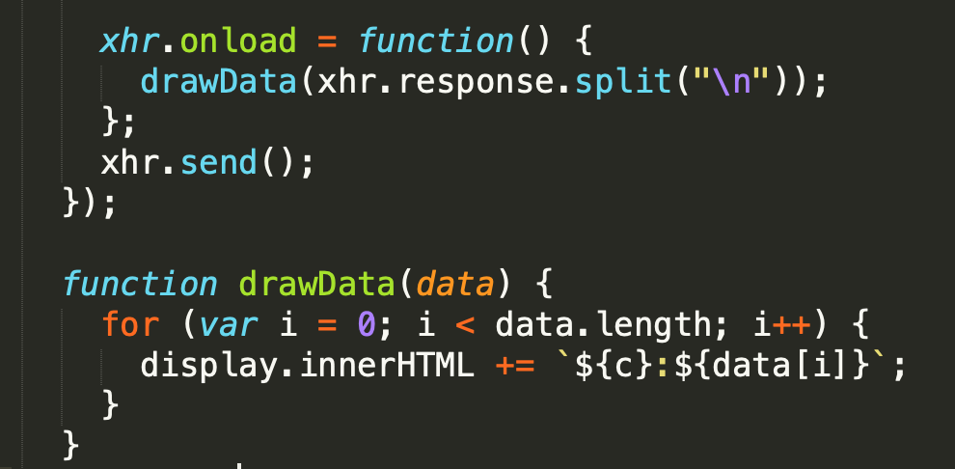

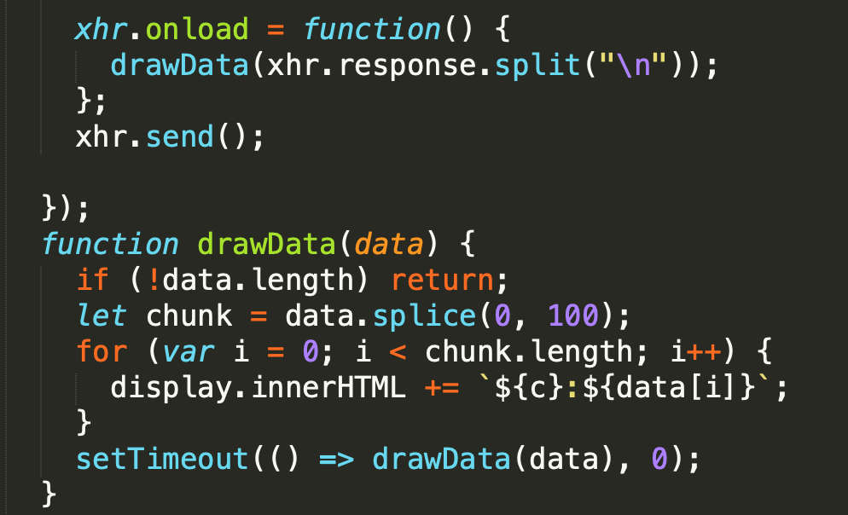
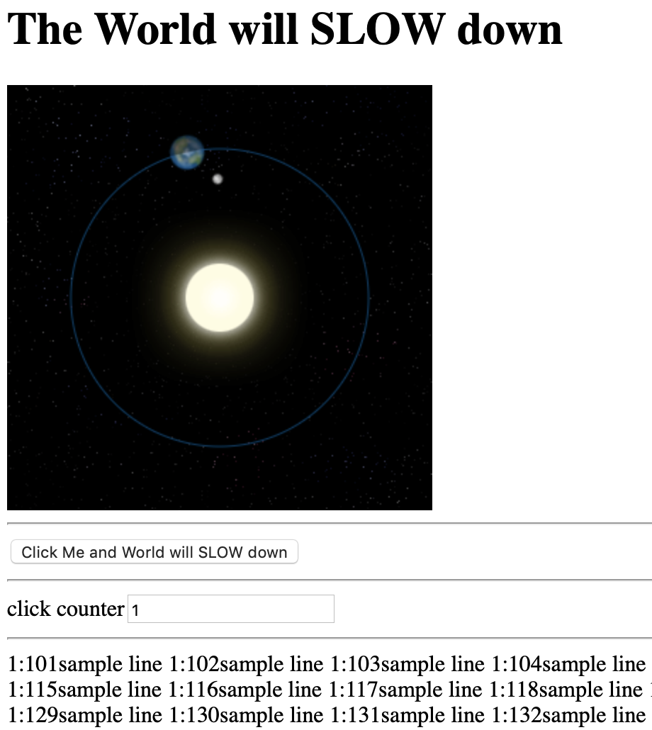
Cooperative Concurrency Demo The World will stop vs. The World will slow down
samples/cooperative/bad
samples/cooperative/good

Slide 57
Cooperative Concurrency
What to do to be cooperative:
Split data to several chunks process with one function (previous sample)
for loop vs recursion
async recursion
async for ....
another async patterns
Split sequence of sync calls to several async calls in async sequence pattern
sequence of asyncified functions

Slide 58
Solutions
Make your own, rozdeluje long tasky na mensie async tasky, rodelujte data (vid predosly example, zalozene na setTimeout)
async.js, cargo, queue a ine
TODO: iné packages
thaw.js https://github.com/robertleeplummerjr/thaw.js thaw.js helps keep the browser from freezing by splitting long computations into small parts which are processed more naturally when the browser isn't busy. This simulates asynchronous behaviour and keeps the browser from freezing. thaw.js thaws frozen browsers.
TODO: pohladajte si dalsie

Slide 59
Callbacks

Slide 60
Callbacks
When your JS program makes async operation, you set up the "response" code in a function (commonly called a "callback"), and the JS engine tells the hosting environment, "Hey, I'm going to suspend execution for now, but whenever you finish with that request, and you have some data, please call this function back.“ (@getify)

Slide 61
Callback signatures
We have already met several callbacks during revious lessons:
cb(err, data)
cb(err)
cb(data)
cb(err, data, data2)
TODO: examples from node and npm modules API

Slide 62
Callbacks (+)
callbacks are by far the most common way that asynchronycity in JS programs is expressed and managed
Indeed, the callback is the most fundamental async pattern in the language
Countless JS programs, even very sophisticated and complex ones, have been written upon no other async foundation than the callback
The callback function is the async work horse for JavaScript, and it does its job respectably
https://github.com/getify/You-Dont-Know-JS/blob/master/async%20%26%20performance/ch2.md

Slide 63
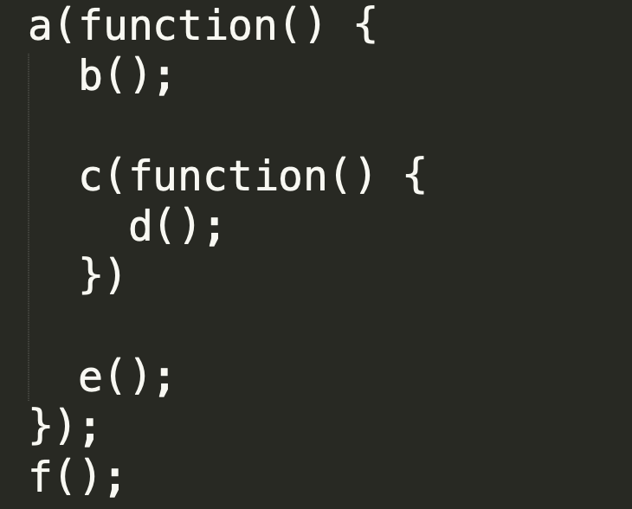

Order of code and execution

Slide 64
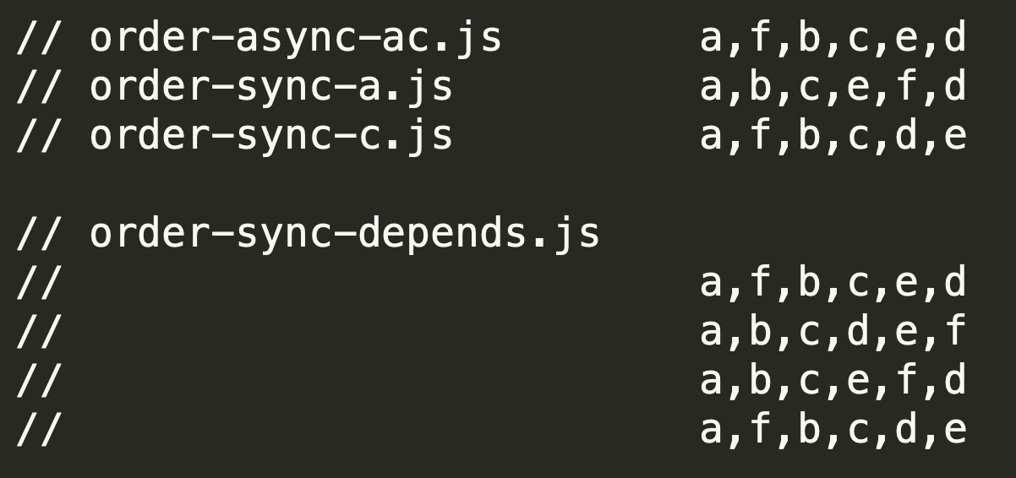
Order of code and execution
prednasky/09-async/samples/callbacks/order-*.js

Slide 65
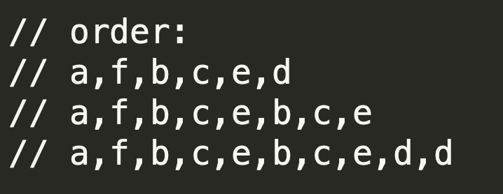
Number of callbacks
prednasky/09-async/samples/callbacks/order-*.js

Slide 66
Callbacks (-)
It turns out that how we express asynchrony (with callbacks) in our code doesn't map very well at all to that synchronous brain planning behavior
The reason it's difficult for us as developers to write async evented code, especially when all we have is the callback to do it, is that stream of consciousness thinking/planning is unnatural for most of us.
We think in step-by-step terms, but the tools (callbacks) available to us in code are not expressed in a step-by-step fashion once we move from synchronous to asynchronous.
And that is why it's so hard to accurately author and reason about async JS code with callbacks: because it's not how our brain planning works.
https://github.com/getify/You-Dont-Know-JS/blob/master/async%20%26%20performance/ch2.md

Slide 67
callback hell
with callback we trust the 3rd party (the one who calls our function) to
call us only once
but it can call us multiple times,
or not at all
call us in the async or sync fashion, but not sync one time and async second time
solvable with some boilerplate code but clutter
order of code is not sequential
hardcoded continuations (names of next functions)
error handling paths complicate the code
error handling of sync parts of async. functions (writeFile and encoding)
cluttered code hard to reason about
... indentation ... is just side effect not helping previous real problems

Slide 68
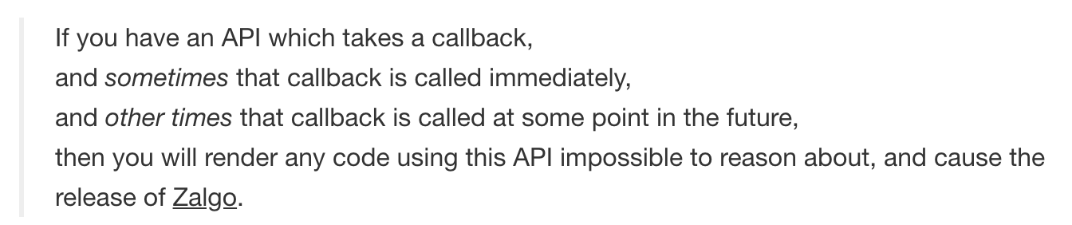
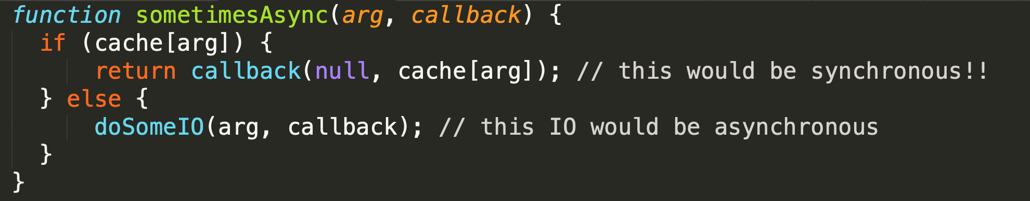
sometimes-async-function
http://blog.izs.me/post/59142742143/designing-apis-for-asynchrony
https://blog.ometer.com/2011/07/24/callbacks-synchronous-and-asynchronous/
prečo je takáto async funkcia problém (ozaj v skratke):
nemôžte sa spoľahnúť na poradie (viď predošlý príklad)
b,c,e .... e vs.
b,c,d,e
Maximum call stack size exceeded

Slide 69
sometimes-async-function, never called, multiple call – solutions ?
Sometimes:
As authors: Do not produce sometimes sync, async functions
As consumers: When consuming sometimes async function wrap it with async.ensureAsync(fn)
Never:
As authors: it is bug, do all callback paths coverage with your tests
As consumers: wrap your functions with async.timeout(fn)
Multiple:
As authors: it is bug, do all callback paths coverage with your tests
As consumers: ???

Slide 70
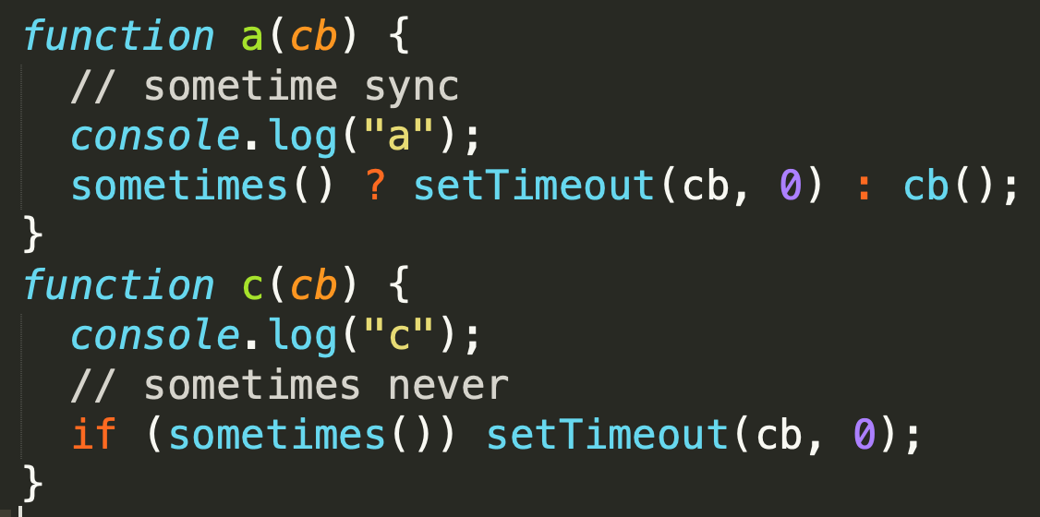

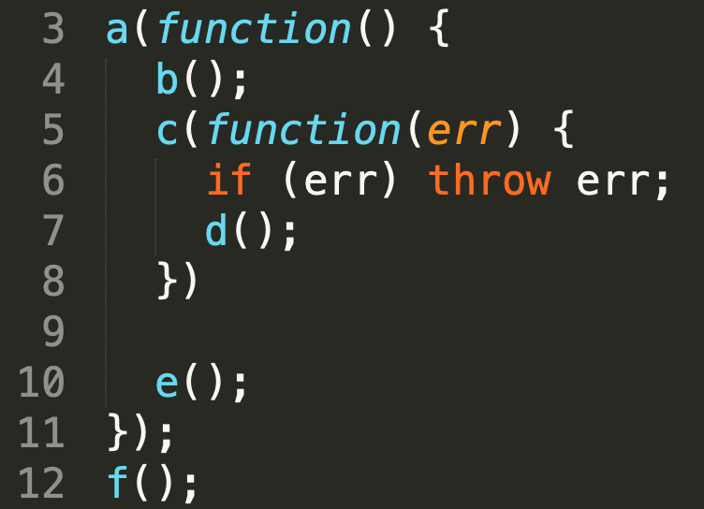
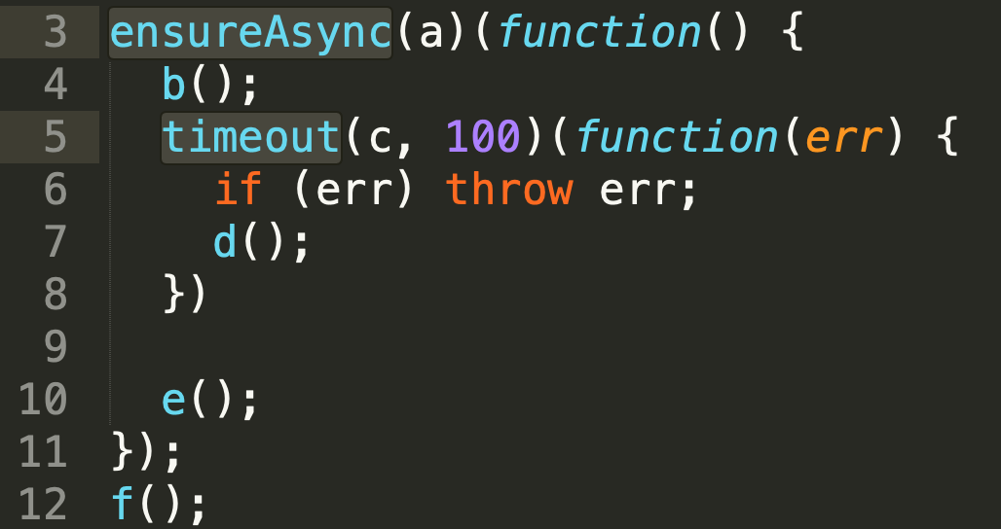
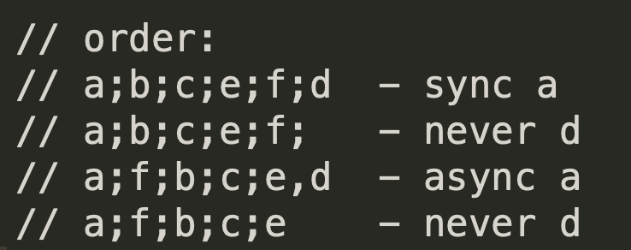
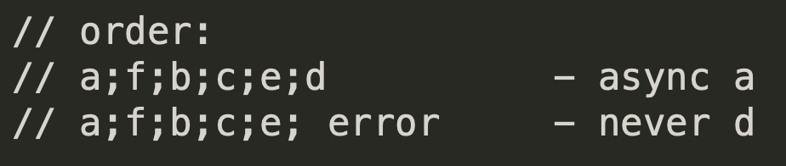
solutions async.ensureAsync and async.timeout

Slide 71

_aux

Slide 72
Links (not reviewed)
https://medium.com/@ExplosionPills/javascript-synchronization-patterns-ec8c05ac05be
https://itnext.io/understand-async-iterators-665259680044

Slide 73
Series/Waterfall – runs in series
Normal JS code
t1
t2
t3
c2
c3
c1
V8 stack
node
Series/waterfall/awaits
V8 stack
t1
c1
t2
c2
t3
c3
node
???
t1
t2
t3
c1
c2
c3
V8 stack
node

Slide 74
https://github.com/getify/revocable-queue/blob/master/README.md

